Slide 1
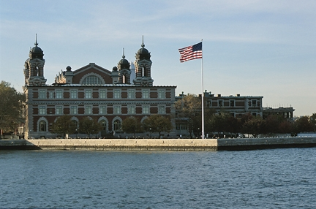
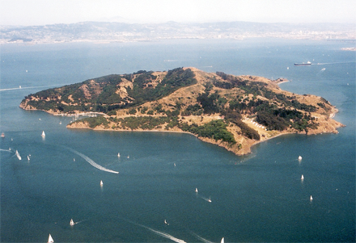
UNIT 2
Urbanization,
Immigration & New Voices
Ellis Island
(NEW YORK)
Angel Island
(San Francisco, CA)

Slide 2
Useful Vocab. Terms
Steerage- the most basic and cheapest accommodations on a steamship.
Nativism- an extreme dislike for immigrants by native-born people and a desire to limit immigration.
Ellis Island- where most immigrants crossing the Atlantic were processed 1880-1920s / they were checked for diseases, skills, and documentation
Jacob Riis- Danish-born journalist observed in 1890 that there was a huge division between rich and poor, studied and described tenement life / book – The Other Side
Angel Island- this island was used to process Asians crossing the Atlantic and to house many Asian immigrants who were denied access into the country / horrible and unfair conditions
Chinese Exclusion Act- this law barred Chinese immigration for over 10 years and prevented the Chinese already in the country from becoming citizens.

Slide 3
Useful Vocab. Terms Cont’d…
Political Machine- informal political group designed to gain and keep power.
Party Boss- a person in control of the political machine.
Graft- technique of getting money through dishonest/questionable means.
Louis Sullivan- designer of the skyscrapers from Chicago. The first American architect.
George Plunkitt- an Irish immigrant who rose to be one of New York’s most powerful party bosses.
William M. “Boss” Tweed- leader of the democratic political machine (Tammany Hall in NY) during the 1860s and 1870s.
Tenement- dark, crowded, multi-family apartments.
Skyscraper- tall, steel frame building.

Slide 4
The Atlanta Compromise
The speech was directed to the President of the United States and the people on the Board of Directors and Citizens (all were white).
The main idea was to stop segregation and get both white and black men to accept each other in the place they lived, the south
Whites: Among people who have without strikes and labor wars, nursing your children, cleared your forests , tilled fields, brought forth treasures from the bowels of the earth
Blacks: progress in the enjoyment of all privileges that will come to us must be the result of severe and constant struggle rather than of artificial forcing; right that all privileges of the law be ours; exercise these privileges
Booker T. Washington suggests that together, white and blacks could help each other and that whites should believe in the blacks.
-Tells blacks to “cast their buckets” into the agriculture, mechanics, commerce and domestic services of white men. He suggests that “there is just as much dignity in tilling a land as there is writing a poem”.

Slide 5
Classes & Living
Engineers and architects developed new approaches to housing and transporting such large numbers of people the skyscraper was possible because of steel, glass, and the elevator.
In exchange for votes, political machines and the party bosses that ran them eagerly provided jobs, housing, food, heat, and police protection for the city dwellers.
Wealthy Class->Fashionable Districts
Middle Class->Doctors, lawyers, engineers, managers, social workers, architects, teachers moved to the suburbs.
Working Class->Lived in tenements. Sent their children to work in factories.
Urban Vs. Rural
City living posed threats such as crime, violence, fire, disease and pollution.
Crime rate rose when people moved into urban life.

Slide 6
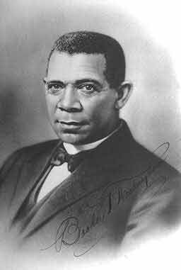
New Voices
Booker T. Washington- was born into slavery in Virginia. Learns that proper etiquette is very important when living amongst white people. He goes to college with no money and asks the University to hire him so he can pay for college, works very hard and lives in the south.
Wrote the book, “Up From Slavery”.
Started Tuskegee Institute
Wrote the “Atlantic Compromise Speech”.
Ideas:
Take a job in practical arts and do a good job.
“Get a job, earn respect, and your rights will follow.”

Slide 7
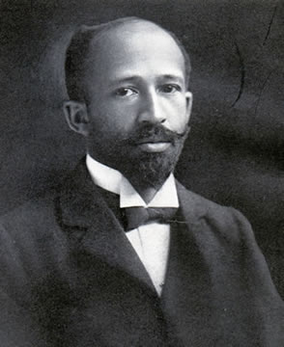
New Voices
W.E.B Dubois- from New England. Family is upper-middle class and he lives in an integrated neighborhood. Graduate of Harvard with two degrees and a PHD in Sociology and Economics.
Writes “Souls of Black Folks”
Editor of a newspaper for the National Association for the NAACP.
Ideas:
Demand Full Political Rights Now!
African Americans be led by the talented tenth.
(Black intellectuals should tell blacks how to fight for their rights.
W.E.B and Booker T. hated each other.

Slide 8
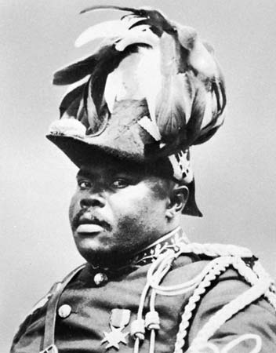
New Voices
Marcus Garvey- He is Jamaican and comes to America to help poor black people. He comes from a poor family. Tells Blacks to be proud and that whites will never accept them so go back to Africa Created his own shipping line for people to go back to Africa (the ships leaked). He was deported from America because of his leaky ships.
Ideas:
Black is beautiful, be proud of yourself.
White people are never going to treat you right, go back to Africa.
Young black men put in military units tot each them discipline.

Slide 9
Immigration
Popular Culture- the cultural traits of society.
New to the Era:
Bought dime novels and magazines. The novels were written in NY about things they knew nothing about (the west, cowboys, Indians, ect…)
Cable cars that run on electricity (public transportation).
Skyscrapers are new and are only possible because of steel frames, windows and elevators.
There were ethnic neighborhoods (Italian, Spanish, Chinese), certain nationalities and religions were grouped together.
Silent movies played on the nickelodeon (Charlie Chaplin, Douglas Fairbanks, Mary Pickford).
Loved baseball, walking in the park, college football, bicycling, and circuses
Immigrants: Immigration (1900-1920) was dominated by the following groups: southern/eastern European countries (Italy, Greece, Poland, Russia, Romania and Yugoslavia).

Slide 10
#10
Why was Chicago a major center for industrialization?
East –west rail center
port

Slide 11
Immigration Cont’d
We don’t like the immigrants:
They are poor.
They have different ways than us.
They take our jobs.
We don’t like their religion. (Catholics, Jewish, ect…)
They want to stick together.
Nativist- we think that our ideas are right & others are wrong.
Melting Pot- different ethnic backgrounds blending together as one. We believe that everyone should adopt our ideas and get rid of their own before they come to the US.
Immigrants come from Europe and land in Ellis Island (health checks, qualification, etc…)

Slide 12
Immigration Cont’d…
Quota Act- 1924, we limited the number of immigrants to a percentage of numbers that came in a base year. Most people came from England, France, and Germany.
Chinese Exclusion Act- there will be no immigration from China to the US. The few that did get in, we made it miserable for them so they would want to leave. 1943, we change the law because China was our ally.
Wealthy:
Croquet, golf, ride bicycles in parks and around town.
Poor:
Carnival, circus, zoo, wild-west show (cowboys and Indians).
Tennis and parks.
Nickelodeon (silent films).

Slide 13
Triangle Factory Fire
What were the working conditions like?
  Sweat shop, dirty, crowded, hot dingy
What did the characters do with their leisure time?
  Ice cream, Dances, Nickelodeons, parties, shopping
Describe the setting of the film?
  New York, Textile factory, Intendments', ghetto, 1911, crowded work condition

Slide 14
Triangle Factory Fire
Why was Gina, the Italian greenhorn in the story?, what did she represent in the film?
  Immigrants coming to New York/ vulnerability of young inexperienced immigrants

Slide 15
Triangle Factory Fire
What did Ruthie and Mr. Feldman represent in the story?
  Everyone has a good side, how middle class people live, everyone works hard, relatives coming to America.

Slide 16
Triangle Factory Fire
What did Connie and Vinnie represent in the story?
  Love and how love isn’t always perfect, Catholic Italian family pressures.

Slide 17
Triangle Factory Fire
What did Flo and the hat symbolize?
  Working for what you want. Dreams

Slide 18
Triangle Factory Fire
What did Sonja and her Jewish family represent in the story?
  Many Jewish, immigrants coming to New York and learning the ways, difference between older generation and new.

Slide 19
Triangle Factory Fire
What did Lou, Mr. Pinkus, and Rose represent in the Story?
  The beginning of union sweat shops and love or security.

Slide 20
Triangle Factory Fire
What role did religion play in the story?
  Heavy role in Judaism and Catholicism. (Won’t have sex with Vinny / sin to work on the sabbath.

Slide 21
Triangle Factory Fire
List five reasons why there was a fire, List five problems in fighting the fire once it started.
  Lack of maintenance, piled up clothing, no one hooked up the waters, lack of intelligence, checking on friends and being materialistic, blocked exits, couldn’t read English, ladder was too short, worked past 5, narrow stairs, fire escape damaged.

Slide 22
Triangle Factory Fire
Why would this have been different today?
  Better safety measures, sprinkler systems, fire extinguishers, trained workers, inspections, building codes.

Slide 23
Triangle Factory Fire
Why did so many die in the fire?
  Didn’t know safety procedures.

Slide 24
Triangle Factory Fire
What did New York do about this problem?
  50,000 people came out on a protest march to make the city, state, and country aware of this problem. Demanded new laws for safety of workers, New York wrote laws to change immediately and became a model for other states.

Slide 25
Urban problems at the turn of the century
Poor working conditions, safety issues, horse manure, disease, dirty, 30 miles of paved roads, high crime rate, congestion-crowded cities, living in tenements, political machines ran the cities, Graft political officials taking bribes.

Slide 26
Urban Problems at the turn of the century continued
What did people get from political machines?
  Hook up water, food, shelter ,clothing, funerals, make neighborhood safe, help find jobs, helps people.

Slide 27
Tenement Facts
Tenements contained no toilets, baths, or showers.
In early tenement life no water was available at all in the houses.
People often moved from apartment to apartment.
Different tenement areas were composed of different ethnic groups.
Crowded with little light or clean air
Took in boarders for extra money
Children worked as early as five
Most tenements were next to docks, factories, and slaughter houses because those were the usual occupations of people of that income level.
Alcoholism was a major issue for the working class of many different tenements.

Slide 28
Ellis Island: Extra Details
Ellis Island first opened in 1892 and was closed in 1954.
Between 1892 and 1954 over 12 million people entered the US through Ellis Island.
Ellis Island is located next to the statue of liberty in the upper part of New York Bay.
Before the immigrants came, the Indians called it “Kioshk” or “Gull Island”.
The first wave of immigrants to enter Ellis Island were of England, Ireland, Germany, and Scandinavian descent.

